Slide 1


SUBJECT CODE
TYPE THE SUBJECT NAME HERE
VLSI IMPLEMENTATION IN HARDWARE SECURITY MODULE BASED ON AES ENCRYPTION METHOD
DATE : 27-02-2023
BATCH NUMBER : C10
PROJECT CODE :
BATCH MEMBERS : A.Akash
P.Jaiganesh
M.Mahizhan
SUPERVISOR : Mr.K.Srinivasan
SDG GOALS : 9
III
VI
20ECPJ601
INNOVATIVE DESIGN PROJECT
LAB

Slide 2


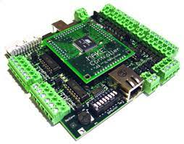

20ECPJ601
220ECPJ601 IDP LAB
PROBLEM STATEMENT
To enhance system security, we would employ our adaption of AES encryption to fortify the hardware security module's security in a Network Centric Warfare Ecosystem.
A HSM(Hardware Security Module) chip is embedded in a Microcontroller of a System.

Slide 3
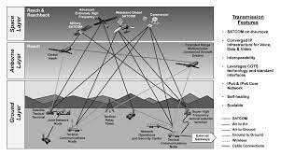
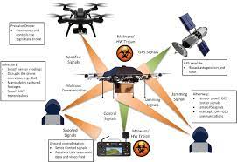
20ECPJ601
220ECPJ601 IDP LAB
OBJECTIVE OF THE PROJECT
Security is becoming a crucial component of contemporary warfare.
Cyberattacks account for the majority of attacks. Cyberattack against Systems, Aircraft, Drones, and other Military Equipment, etc.
These seriously harm a nation's collateral. In order to achieve our goal of improving system security, we would use our adaptation of AES encryption to strengthen the security of the hardware security module, which is an HSM (Hardware Security Module) chip implanted in the system controller.

Slide 4
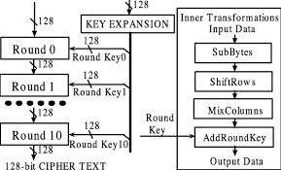

20ECPJ601
C8811
220ECPJ601 IDP LAB
METHODLOGY
We would examine the most recent version of AES encryption first, modify it to reach the algorithm's optimum efficiency, and then implement it in a Hardware Security Module.
After that We would implement into a Controller for further study of the Security of the Controller System.
2

Slide 5
20ECPJ601
C8811
220ECPJ601 IDP LAB
LITERATURE REVIEW
S.no | Journal details And Year | Authors and title of the paper | Inference
1 | Journal of Electrical Systems and Information Technology 2 (2015) 178–183 | Power efficient and high performance VLSI architecture for AES algorithm K. Kalaiselvi a,∗, H. Mangalam | Advanced encryption standard(AES) algorithm has been widely deployed in cryptographic applications. This work proposes a low power and high throughput implementation of AES algorithm using key expansion approach.
2

Slide 6
20ECPJ601
C8811
220ECPJ601 IDP LAB
S.no | Journal details And Year | Authors and title of the paper | Inference
2 | IEEE 2013 | VLSI IMPLEMENTATION OF AES ALGORITHM SAURABH KUMAR | This paper presents In the past cryptography means only encryption and decryption using secret keys, nowadays it is defined in different mechanisms like asymmetric-key encipherment (public key cryptography) and symmetric-key encipherment (called as privet-key cryptography).
2

Slide 7
20ECPJ601
C8811
220ECPJ601 IDP LAB
S.no | Journal details And Year | Authors and title of the paper | Inference
3 | IEEE 2017 | VLSI Implementation of Cryptographic Algorithms & Techniques: A Literature Review Favin Fernandes, Gauravi Dungarwal, Aishwariya Gaikwad, Ishan Kareliya, Swati Shilaskar | Through the years, the flow of Data and its transmission have increased tremendously and so has the security issues to it. Cryptography in recent years with the advancement of VLSI has led to its implementation of Encryption and Decryption techniques, where the process of translating and converting plaintext into cypher text and vice versa is made possible
2

Slide 8



20ECPJ601
C8811
220ECPJ601 IDP LAB
JUSTIFICATION FOR SDG & SAP
SDG Goal : Industry, Innovation and Infrastructure
SAP Indicator: 9 Support domestic technology development, research and innovation in developing countries, including by ensuring a conducive policy environment for, inter alia, industrial diversification and value addition to commodities.
2
Primary Goal
Secondary Goal
Tertiary Goal

Slide 9

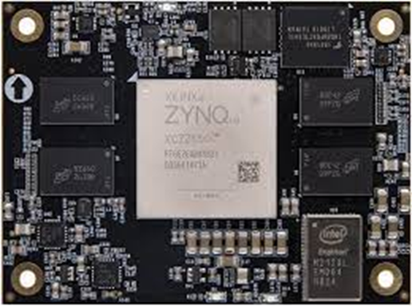
20ECPJ601
C8811
220ECPJ601 IDP LAB
COMPONENT OF THIS PROJECT
2
SOFTWARE REQUIREMENT
HARDWARE REQUIREMENT
XILINX ISE DESIGN SUITE 14.7
ZNQC FPGA Board

Slide 10
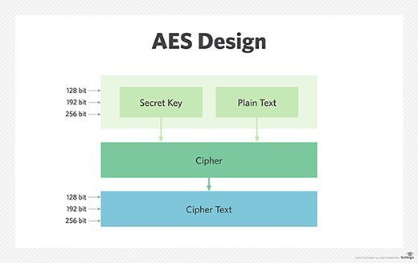
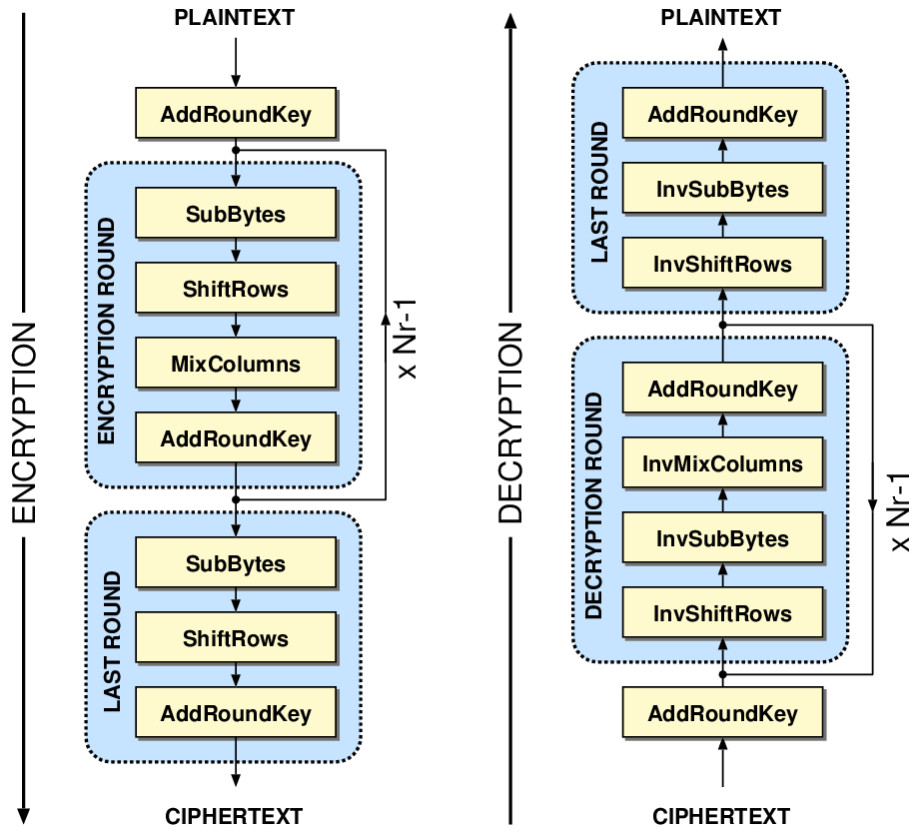
20ECPJ601
C8811
220ECPJ601 IDP LAB
Advanced Encryption Standard (AES)
AES is a type of cryptography algorithm.
It performs the encryption and decryption operation. The input information is known as plaintext and encrypted form is called as ciphertext.
Ciphertext contains the plaintext information, but it is not in a readable form to humans. Encryption procedure is varied to one algorithm to another algorithm. Without the key ciphertext cannot be used to encrypt or decrypt.
AES has proven to be more efficient than its encryption processors. AES is mainly used in voice communication, network applications, vertical private network, secured socket layer (SSL)
2

Slide 11
20ECPJ601
C8811
220ECPJ601 IDP LAB
TYPES OF AES Algorithm
 | AES 128 | AES 192 | AES256
SPEED | Faster | Approximately 5 times slower than 128 Bit. | Approximately 6 times slower than 128 Bit.
ROUND | 10 | 12 | 14
EFFICIENY | Efficient | More Efficient | Most Efficient
KEY LENGTH | 128 bits | 192 bits | 256 bits
NO OF BLOCK SIZE | 4 | 4 | 4
POSSIBLE COMBINATION | 3.4 * (10 ^ 38) | 6.2 * (10 ^ 57) | 1.1 * (10 ^ 77)
2

Slide 12
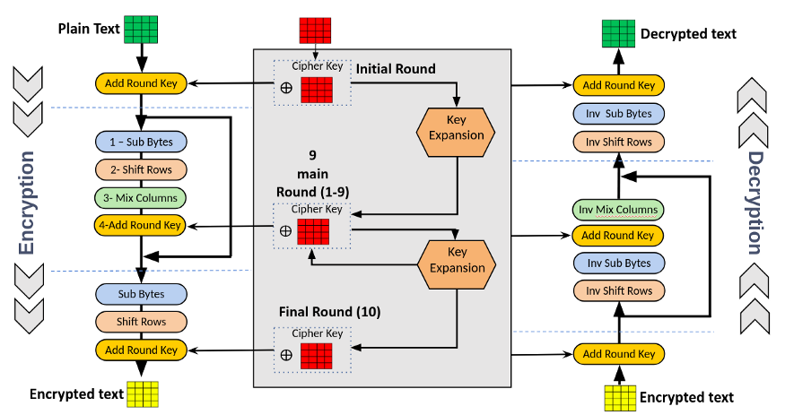
20ECPJ601
220ECPJ601 IDP LAB
BLOCK DIAGRAM OF AES
2

Slide 13
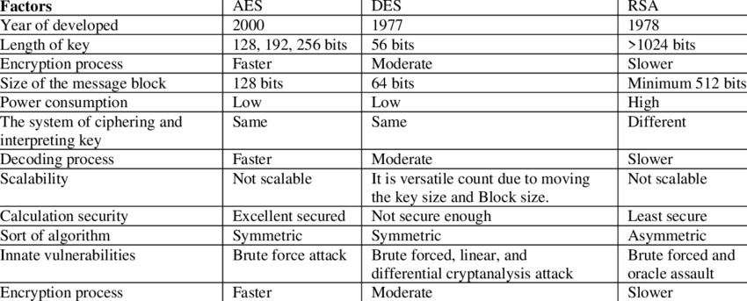
20ECPJ601
C8811
220ECPJ601 IDP LAB
AES VS DES VS RSA
2

Slide 14
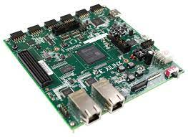
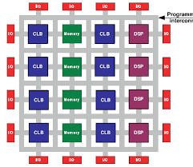
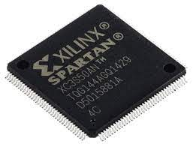
20ECPJ601
C8811
220ECPJ601 IDP LAB
FPGA
Field Programmable Gate Arrays (FPGAs) are semiconductor devices that are based around a matrix of configurable logic blocks (CLBs) connected via programmable interconnects.
FPGAs can be reprogrammed to desired application or functionality requirements after manufacturing.
This feature distinguishes FPGAs from Application Specific Integrated Circuits (ASICs), which are custom manufactured for specific design tasks.
Although one-time programmable (OTP) FPGAs are available, the dominant types are SRAM based which can be reprogrammed as the design evolves
2

Slide 15
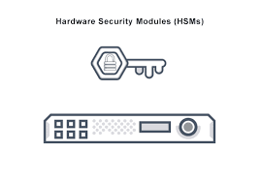
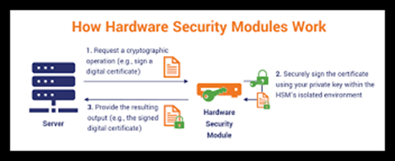
20ECPJ601
C8811
220ECPJ601 IDP LAB
HARDWARE SECURITY MODULE
A hardware security module (HSM) is a physical computing device that safeguards and manages digital keys, performs encryption and decryption functions for digital signatures, strong authentication and other cryptographic functions.
These modules traditionally come in the form of a plug-in card or an external device that attaches directly to a computer or network server.
A hardware security module contains one or more secure crypto processor chips
2

Slide 16
20ECPJ601
C8811
220ECPJ601 IDP LAB
PROJECT TIMELINE
PHASE 1
Understanding and researching the basics of cryptography, the AES Encryption method, hardware security, and Xilinx software constitutes phase 1 of the project.
By the end of Fifth Semester all of these research studies will be finished.
2
Once the aforementioned phase's research has been completed.
For these algorithms (AES-128, AES-192, and AES-256), we would create programs in HDL or Verilog and undertake case studies to analyze the outcomes.
All of these case studies regarding the results will be completed by the end of the sixth semester.
PHASE 2

Slide 17
20ECPJ601
20ECTE401-LIL-3
Once case studies on the effects of the HDL programs we had developed in earlier stages had been completed.
The advantages and disadvantages of the encryption algorithm would be listed.
In order to correct it, we would employ deep learning and other ideas to improve the system's security and effectiveness in comparison to the AES technique.
By the end of the seventh semester, the algorithm update will have been finished.
PHASE
3
2
PHASE
4
We'd use an FPGA to implement our project's most current algorithm in the project's final phase (Field Programmable Gate Array).
Our project study paper would be published in numerous journals.
Last, we would convert our code to VHDL and System Verilog.
The Project's objective will have been achieved.
This is going to be finished by the conclusion of the Eighth semester.

Slide 18
20ECPJ601
C8811
220ECPJ601 IDP LAB
PROBLEM IN AES 256 ENCRYPTION
From a survey of the literature, we identified two problems: area and power use. A sophisticated algorithm, like AES 256, must be crammed onto an integrated circuit using VLSI architecture. Implementing AES 256 calls for a sizable number of gates and a lot of memory, which can lead to excessive power and area consumption.
Designers must therefore optimize the design to reduce space and energy usage.
Timing is crucial in VLSI design, because timing errors can lead to functional problems. The design must operate at fast speeds while adhering to timing restrictions. Many sequential processes are needed for AES 256, which might lengthen the critical path and cause timing issues.
The security of VLSI architecture for AES 256 encryption must be carefully considered. The architecture must be resistant to side-channel assaults, which can decrypt data by examining the system's power usage, electromagnetic emissions, or other features. To defend against attacks that target the encryption key, the architecture must also include secure key management and storage.
To make sure the design satisfies the expected functionality and performance criteria, rigorous verification is required. An implementation of AES 256 needs to be thoroughly examined for accuracy and security.
2

Slide 19
20ECPJ601
C8811
220ECPJ601 IDP LAB
SOLUTION TO FIXED THE PROBLEM
Parallelism: Sub Bytes, Shift Rows, Mix Columns, and AddRoundKey are all sequential operations used in AES 256 encryption.
Parallelism can be used by designers to perform these operations concurrently, reducing the number of clock cycles required for encryption.
Pipelining is a technique that divides a computation into smaller sub-tasks that are processed concurrently. This technique can be used with the AES 256 algorithm, where sequential operations can be divided into smaller sub-tasks and processed concurrently. This can increase system throughput while decreasing critical path delay.
By implementing some of the operations in hardware, custom instructions can be used to accelerate the execution of the AES 256 algorithm. This can help to reduce the number of clock cycles required for encryption while also increasing efficiency.
The AES 256 algorithm necessitates a large amount of memory for the S-box and key schedule. Designers can optimize memory usage by implementing a custom memory architecture tailored to the AES 256 algorithm's specific requirements. Power consumption is an important consideration in VLSI design.
Power optimization techniques such as clock gating, power gating, and voltage scaling can be used by designers to reduce power consumption without sacrificing performance.
2

Slide 20
20ECPJ601
C8811
220ECPJ601 IDP LAB
CONCLUSION
AES encryption is the finest encryption among RSA, DES, and AES, as we have learned by studying encryption techniques. This uses the most recent version of AES (256).
This leads us to the conclusion that this project might have research on the definition of cryptography, the AES encryption algorithm, and Xilinx software. From this study, we would modify the AES Encryption algorithm in the best way possible and implement it in the FPGA kit.
2

Slide 21

20ECPJ601
C8811
220ECPJ601 IDP LAB
FUTURE SCOPE
We intended to enhance this project by using an FPGA kit to implement the optimal algorithm in the h circuit.
Embed this in a controller so that we could check the controller's security and create a commercial product.
2
Security in NFC

Slide 22
20ECPJ601
C8811
220ECPJ601 IDP LAB
References
Kumar, Pramod, T. V. Narendra, and N. A. Vinay. "Short Hand Recognition using Canny Edge Detector." International Journal 7, no. 5 (2017).
Kumar, Mamatha MS Pramod, and M.Mamatha. "FPGA Implementation Of Low Area Single Precision Floating Point Multiplier."International Journal of Science Technology and Engineering, Vol.2, no. 2 (2016): 560-566.
M.Natheera Banu, FPGA Based Hardware Implementation of Encryption Algorithm, International Journal of Engineering and Advanced Technology (IJEAT) ISSN: 2249 8958, Volume-3, Issue-4, April 2014.
Deguang Le, Jinyi Chang , Xingdou Gou , Ankang Zhang ,Conglan Lu ,Parallel AES Algorithm for Fast Data Encryption on GPU, IEEE journal on AES 2010.
K. Xinmiao Zhang, High speed VLSI architectures for the AES algorithm ,IEEE transactions on VLSI systems, Tech. Rep., sep2004.
National Institute of Standards and Technology, Advanced Encryption Standard, Federal Information Processing Standards 197, November 2001.
M.Pitchaiah, Philemon Daniel, Praveen, Implementation of Advanced Encryption Standard Algorithm, International Journal of Scientific Engineering Research.
2

Slide 23
20ECPJ601
C8811
220ECPJ601 IDP LAB
PROJECT MANAGEMENT- GANTT CHART
WORK | SEPT22 | OCT22 | NOV22 | DEC22 | JAN23
PROJECT APPROVAL
LIT REVIEW
SIMULATION
HARDWARE
THESIS
CONTEST
JOURNAL PUBLICATION
2

Slide 24
20ECPJ601
C8811
220ECPJ601 IDP LAB
2
THANK YOU

